Slide 1


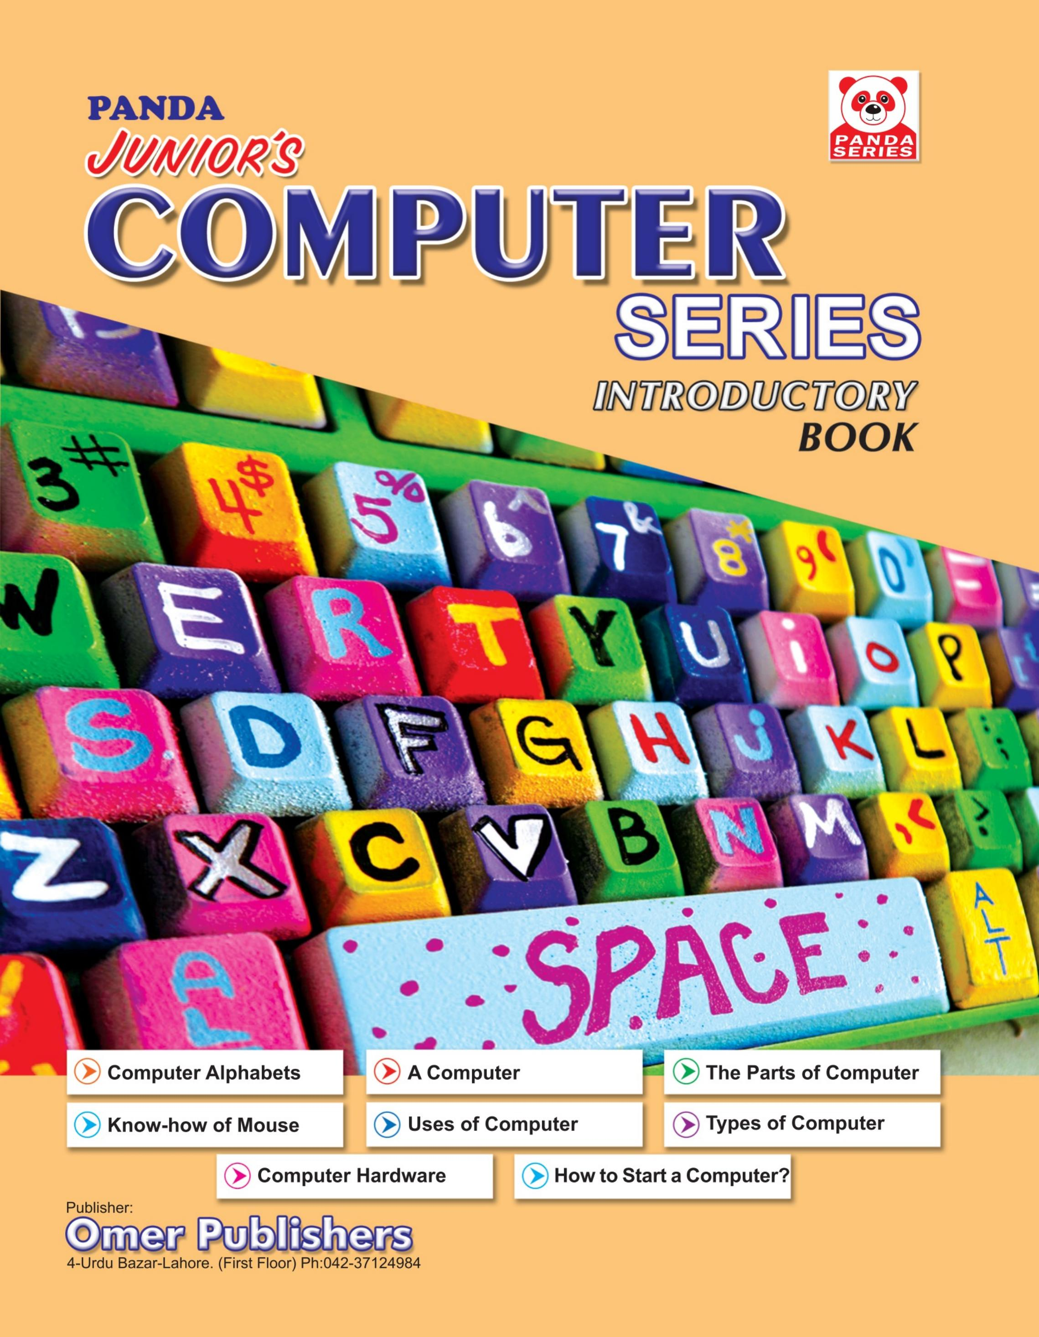
Panda Junior's Computer
Introductory • Age 4+
An activity-based early-years book from the Panda Series.
A Project of Azhar Publishers & Book Factory

Slide 2
i
What's Inside
Panda Junior's Computer Introductory • Age 4+
1
Computer alphabets
2
What a computer is
3
The parts of a computer
4
Know-how of the mouse
5
Uses and types of computers
6
Computer hardware & how to start

Slide 3
★
Purpose & Classroom Support
Introduces young learners to computers in a simple, picture-led way — building early digital awareness and confidence.
“
Every book comes with
1
2
3
Teacher's Lesson Plan
Practice Papers
Digital Interactive Version
A 40-week lesson plan that guides teachers, day by day.
Monthly tests and term exam papers for children to attempt.
An interactive flipbook and digital exercises for engaging, screen-based practice.
A Project of Azhar Publishers & Book Factory

